Slide 1
Push Notifications with SharePoint WebHooks
SharePoint Saturday Helsinki
Tomi Tavela
Valo Intranet / Sininen Meteoriitti

Slide 2
Agenda
SharePoint WebHooks
Azure Functions
Azure Notification Hub
iOS Application
3 steps:
Subscribe devices to receive push notifications
Subscribe Azure Functions to receive notifications from SharePoint
Send notification from SharePoint to devices
Demo times!!

Slide 3
SharePoint WebHooks
Available in SharePoint Online
Gets triggered when something happens in a list
Will send a POST request to the subscribing endpoint
Request contains information of the resource changed (json)
What about other options?
Workflow
Remote Event Receiver
Microsoft Flow
Azure Logic Apps
https://dev.office.com/sharepoint/docs/apis/webhooks/overview-sharepoint-webhooks

Slide 4
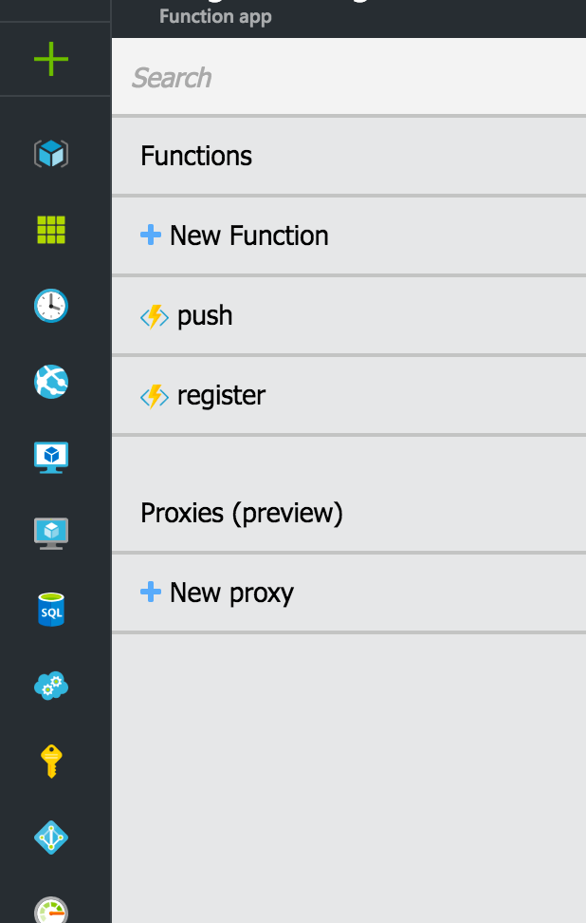

Azure Functions
Serverless applications in Azure
Call API -> execute code
In the Demo:
endpoints
/register
For registering devices with Notification Hub
/push
For sending notifications to Notification Hub
https://azure.microsoft.com/en-us/services/functions/

Slide 5
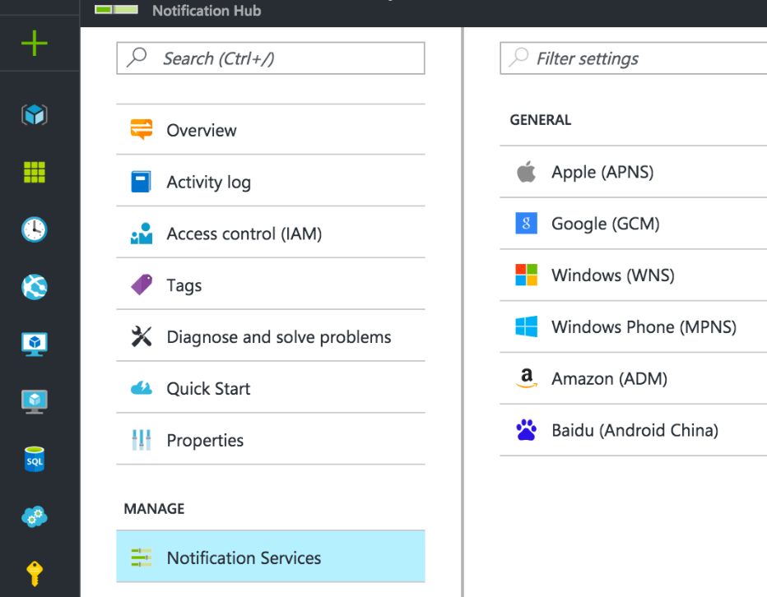

Azure Notification Hub
Manages all devices that are registered
Id
Tags
Manages Platform Notification Systems
Apple Push Notification Service, APNS
Firebase Cloud Messaging (google), FCM
Windows Notification Service, WNS
https://azure.microsoft.com/en-us/services/notification-hubs/

Slide 6

iOS Application
Created with Ionic Framework (v2)
What does it do?
Gets specific device id from Platform Notification Service
Sends that device id to Azure Functions
Azure Functions will add it to Notification Hub
https://ionicframework.com/

Slide 7
Step 1: Subscribe devices to receive push notifications
device id
/register
APNs
device id
device id

Slide 8

Step 2: Subscribe for notifications from SharePoint
validationtoken
/push
validationtoken

Slide 9
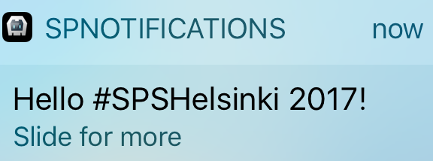
Step 3: Send notification from SharePoint to devices
APNs

Slide 10
Demo times!
https://github.com/tavikukko/sps-helsinki-2017

Slide 11
Thank You, questions?
SharePoint Saturday Helsinki
Tomi Tavela
Valo Intranet / Sininen Meteoriitti

